Slide 1

Payment Analyst
Presentation

Slide 2
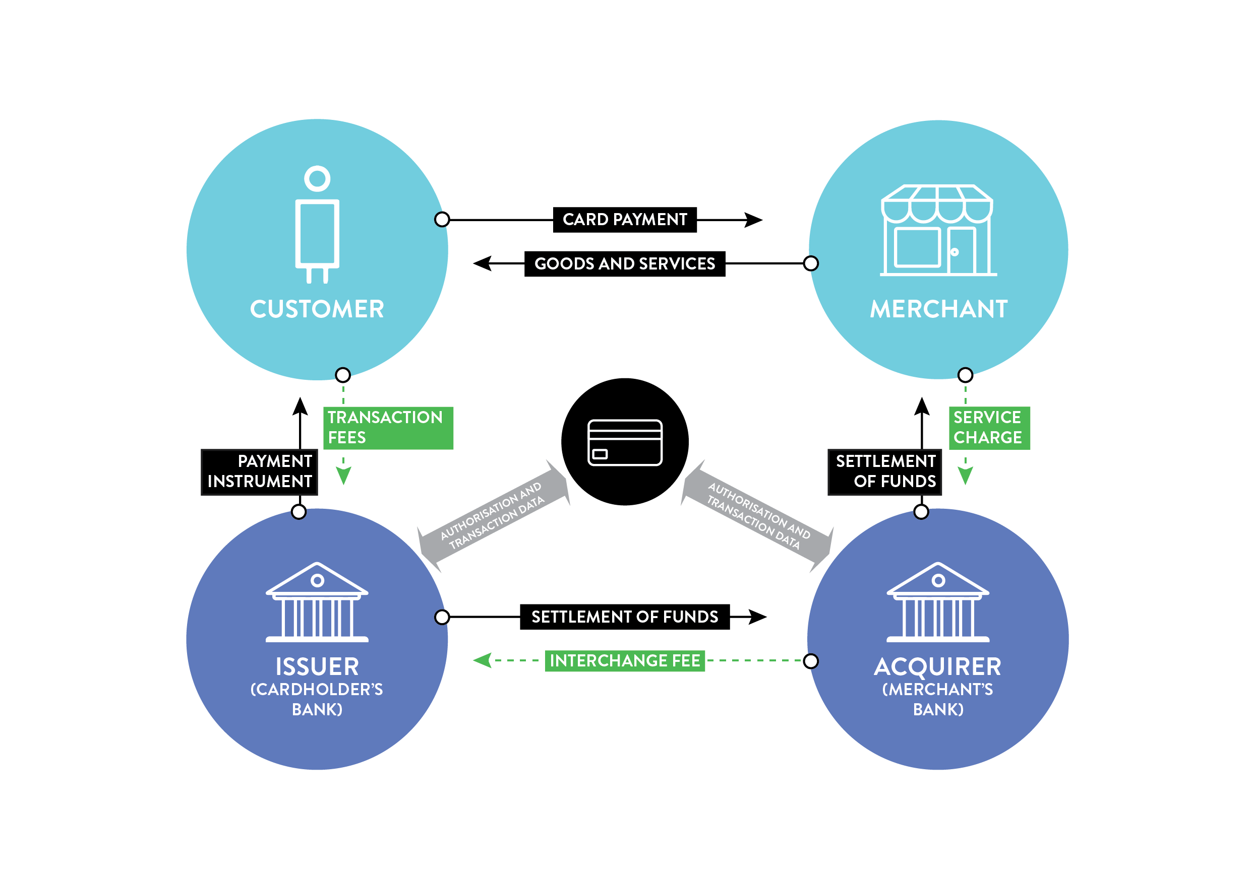
The Payment industry
Notes:
Setor de Pagamentos
Def Payment Industry, Acquirer

Slide 3
Information flow - terminology
Acquirer
Sub-Acquirer
Payment Gateway

Slide 4
Chargebacks a.k.a friendly fraud
What are they?
Whom foots the bill?
Notes:
Explain what chargebacks are, how they differ from a cancellation and what is their connection with fraud in the acquiring world.

Slide 5
2.2 Solve the problem
A client sends you an email asking for a chargeback status… the issuer has not accepted our defence…the cardholder continued to affirm that she did not receive the product, and our documents were not sufficient to prove otherwise. You respond to our client informing that the issuer denied the defence, and the next day he emails you back, extremely angry and disappointed, claiming the product was delivered and that this chargeback is not right.
Considering that the chargeback reason is “Product/Service not provided”, what would you do in this situation?
Notes:
A client sends you an email asking for a chargeback status. You check the system and see that we have received his defence documents and sent them to the issuer, but the issuer has not accepted our defence. They claim that the cardholder continued to affirm that she did not receive the product, and our documents were not sufficient to prove otherwise. You respond to our client informing that the issuer denied the defence, and the next day he emails you back, extremely angry and disappointed, claiming the product was delivered and that this chargeback is not right.
I would explain to the client that in this case

Slide 6
2.2 Solve the problem – My Response
Prezado cliente,
Entendo sua decepção com o resultado da recente disputa. Quero assegurar-lhe que valorizamos seu negócio e que estamos comprometidos em ajudá-lo a minimizar tais problemas no futuro. Embora não possamos reverter a decisão, gostaria de oferecer algumas medidas para ajudar a reduzir o risco de disputas semelhantes:
Ao enviar produtos, mantenha registros detalhados da transação, incluindo números de rastreamento, confirmação de entrega e qualquer comunicação com o cliente. Essas evidências podem ser valiosas em uma disputa de pagamento.
Implemente uma política clara de reembolso - isso reduz o risco de um cliente recorrer ao Chargeback.
Se você suspeitar que o cliente cometeu fraude, poderá colocá-lo na lista negra de compras em sua plataforma.
Agradecemos sua parceria contínua e esperamos seguir trabalhando juntos para garantir os melhores resultados possíveis no futuro.
Atenciosamente,
Notes:
Dear client,
I can understand your frustration with the outcome of this dispute. Unfortunately, once the Issuer makes a decision, the decision cannot be reversed. However, these are steps you can take to reduce the risk of losing disputes in the future:
When shipping products, keep detailed records of the transaction, including tracking numbers, delivery confirmation, and any communication with the customer. This evidence can be valuable in a payment dispute.
Implement a clear refund policy – this reduces the risk of a customer resorting to using Chargeback
If you suspect that the client committed fraud, you can blacklist them from making purchases on your platform.
Please reach out if you have any further queries.
Regards,

Slide 7
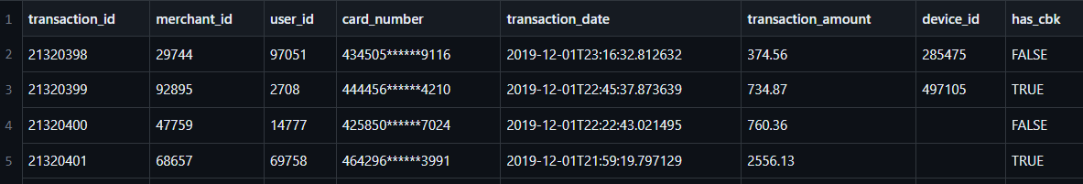
Data analysis

Slide 8
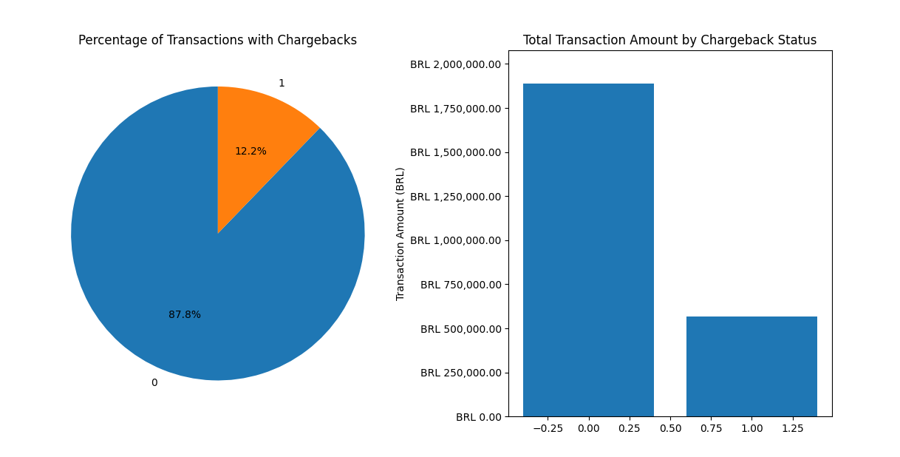
Data analysis

Slide 9
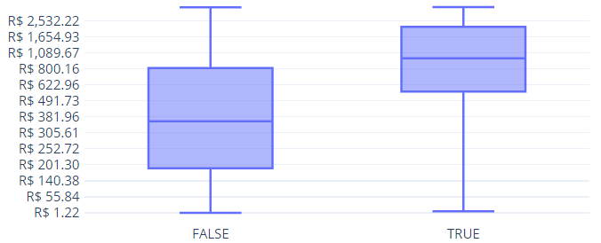
Data analysis – Distribution
Transaction_amount
Has_cbk
Notes:
Box Plot showing far more variance between

Slide 10
Data analysis – time of day
Transaction_count
Has_cbk
Notes:
Box Plot showing far more variance between

Slide 11
Data analysis – Chargeback rates
Notes:
Card Number is the best indicator for cbk risk

Slide 12
Data analysis – other information to monitor
Location of merchant, customer
type of merchant]
Product purchased
marketing source to purchase.
1% in considered an acceptable but the current data is not complete enough to evaluate this.
Notes:
. In addition to the spreadsheet data, what other data would you look at to try to find patterns of possible frauds?

Slide 13
Data analysis - Conclusions
Considering your conclusions, what could you do to prevent frauds and/or chargebacks?
Block Merchants who fail to maintain a reasonable chargeback threshold
Block bank cards and user accounts of repeat offender customers

